Slide 1
GoalManager
Matthew Tennis | Andrew Keller | Miguel Morell
CSCI 4712: Senior Capstone Week 10

Slide 2
GoalManager Use Cases

Slide 3
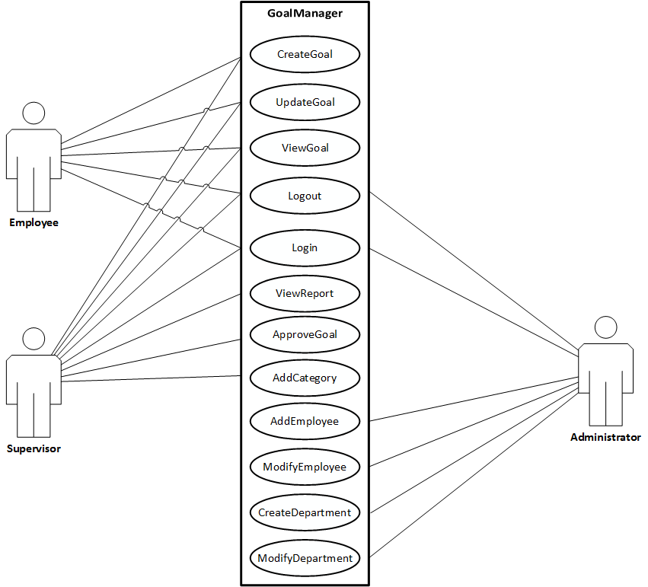
Use Case Description

Slide 4
New Use Case Implementation

Slide 5
CreateGoal

Slide 6
CreateGoal I
User must be authenticated
Access of View is restricted to logged in Employees and Supervisors
CreateGoal controller queries the database context for:
Authentication
The Department ID related to the logged-in User ID
The Categories related to that Department ID
The Quarters related to that Department ID

Slide 7
CreateGoal II
Controller binds data from context to:
List<> objects for presenting Drop Down Lists to View
Controller validates form data:
Instantiates a Goal object
Satisfies FK constraint to UID through navigation property User
Records StartDate property
EndDate property determined by chosen Quarter
Category property determined by chosen Category
Goal written to database context
Initial Update written to database context
Database context adds a new record in tables Goals and Updates

Slide 8
ViewGoal

Slide 9
ViewGoal
ViewGoal is accessed through either EmployeeHome or SupervisorHome*
A “View” button appends every row of the table of Goals presented on EmployeeHome and SupervisorHome*
Passes hidden form field of the associated Goal’s ID (GID)
Controller accesses data from database context query for associated Goal
Send selected Goal data to View to present
Query database context for all Updates associated to selected Goal
Sends Updates data to View to present

Slide 10
UpdateGoal

Slide 11
UpdateGoal
UpdateGoal is accessed from either EmployeeHome or SupervisorHome*
An “Update” button appends every row of the table of Goals presented on EmployeeHome and SupervisorHome*
UpdateGoal controller collects Subject, Notes, and Progress
Time of Update recorded
Writes new Update to database context

Slide 12
New Implementation of Use Case Scenarios and Nonfunctional Requirements

Slide 13
MainView

Slide 14
MainView
MainView is redirected from Log In
Contains logic for UserDB and IdentityDB associations, User roles, and deploying either EmployeeHome, SupervisorHome, or AdminHome
MainView uses limited Session data variable to reduce queries to database
Simple integer and string keys from database context objects are stored in Session
Improves performance on Views that need database information but need not access it directly.

Slide 15
/Data/PartialData.cs

Slide 16
/Data/PartialData.cs I
Entity Framework Database First
Database First generates entity objects and navigation properties from a database.
C#.NET MVC uses Data Annotations for simplifying object properties
Database First necessitates losing any annotations stored in the EF entity classes.
By using the data annotation [MetadataType(Type t)], we are able to extend partial classes and merge existing properties with ones annotated with validation.

